Slide 1

School of Physics
State of the School Address
Feryal Ozel, Chair
EBB – Children’s Healthcare of Atlanta Room
August 28, 2023

Slide 2

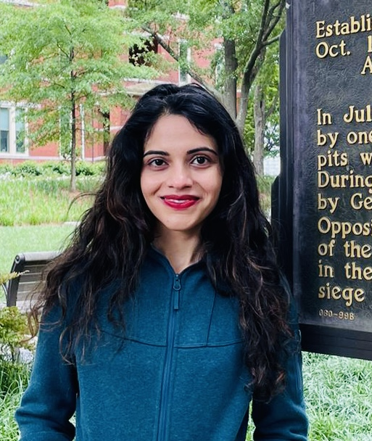

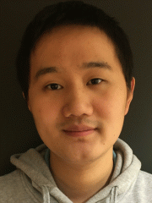
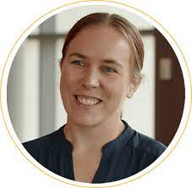
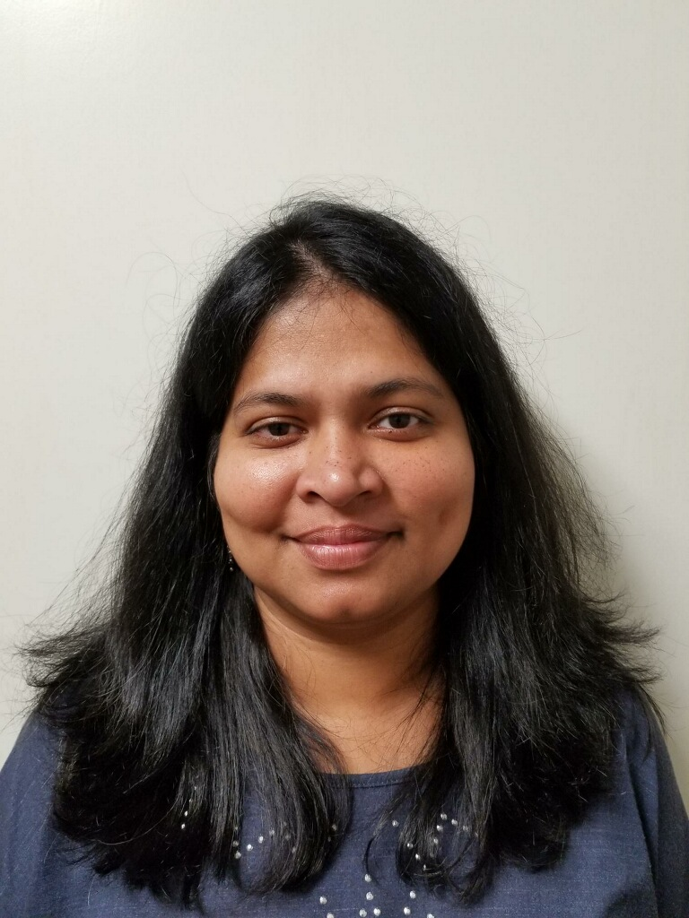
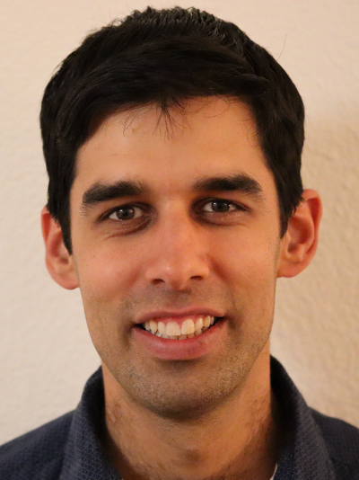
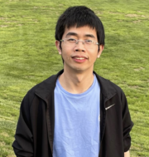
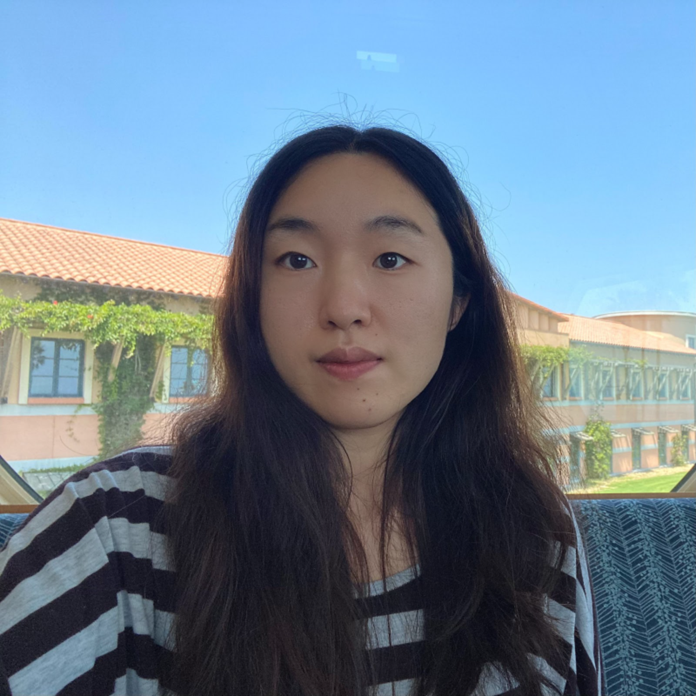
New Faculty
Surabhi Sachdev
Assistant Professor
Nov 2022
Chunhui Du
Assistant Professor
Jul 2023
Hailong Wang
Assistant Professor
Jul 2023
Audrey Sederberg
Assistant Professor
Aug 2023
Prabha Padukka Academic Professional
Aug 2023
Itamar Kolvin
Assistant Professor
Nov 2023
Xueda Wen
Assistant Professor
Jan 2024
Zhu-Xi Luo
Assistant Professor
Aug 2024

Slide 3
New Post-docs & Research Scientists
Postdoctoral Scientists
Ruby Shi
Mark Avara
Mariia Fedkevych
Miles Wetherington
Matthew Golden
Kim Chabein
Qicheng Tang
Wenqian Sun
Shuaifeng Guo
Aniruddha Bhattacharya
Sachin Barthwal
Arnab Seth
Bahadir Catalbas
Hubble Fellow
Matthew Liska
Research Scientists
Rachel Conn
Haoyu Sun
Deniz Kerimoglu
Mahir Patel
Andrew McEntaggart

Slide 4
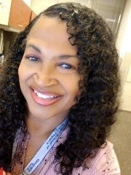

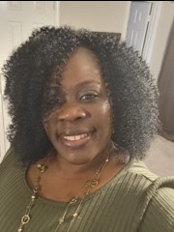
New Staff
Carol March
Academic Program Coordinator
Judy Rivers
Administrative Manager
Telisha Kendall
Administrative Supervisor

Slide 5
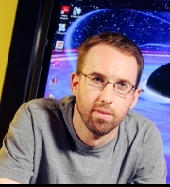
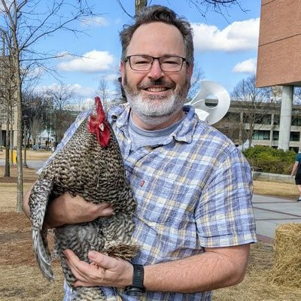

SoP Associate Chairs
David Ballantyne
Associate Chair for Academic Programs
Edwin Greco
Associate Chair for Student Success
Chandra Raman
Associate Chair for Research & Faculty Development

Slide 6
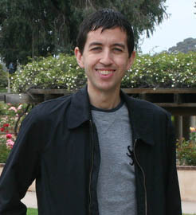
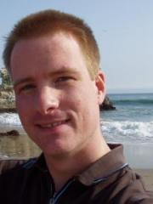
Promotion and Tenure
Promotion to Full Professor rank
JC Gumbart
Nepomuk Otte
Promotion to a Senior Academic Professional rank:
Martin Jarrio
Promotion to a Research Scientist II rank:
Anna Pavlova

Slide 7
New Leadership Roles
John Wise: was appointed the new CRA Director in
January 2023
Ignacio Taboada: was re-elected for second term as spokesman of the IceCube collaboration.
Zhigang Jiang and Zeb Rocklin: were selected to
lead two new Imat Initiatives

Slide 8
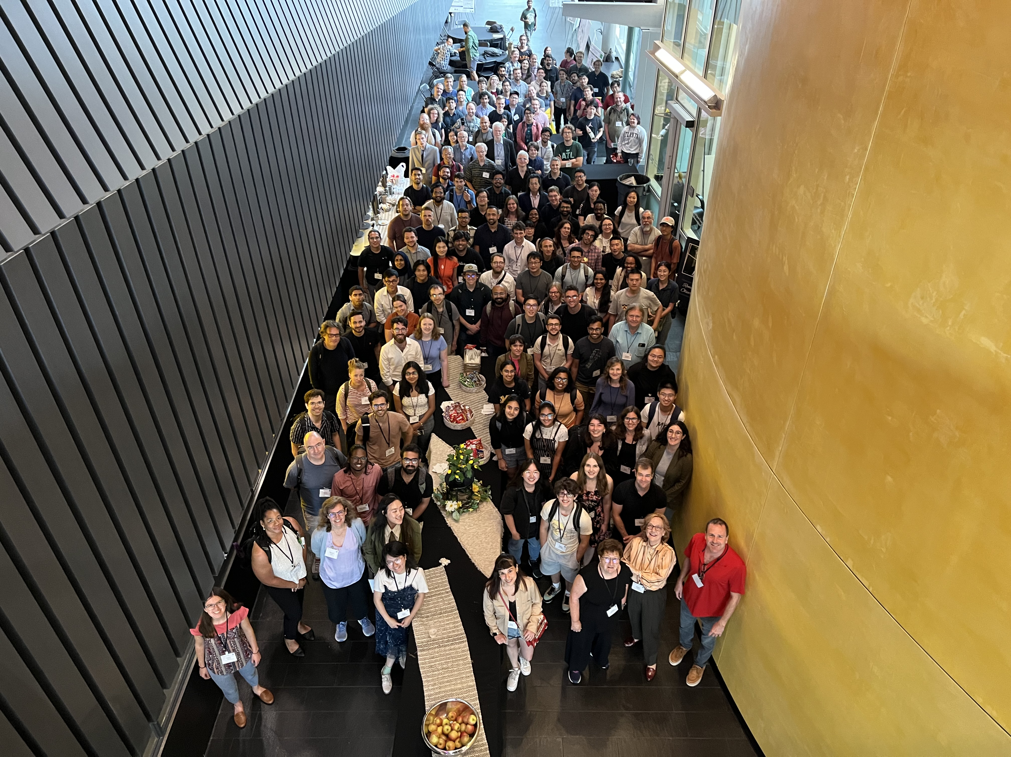
Research Highlights

Slide 9
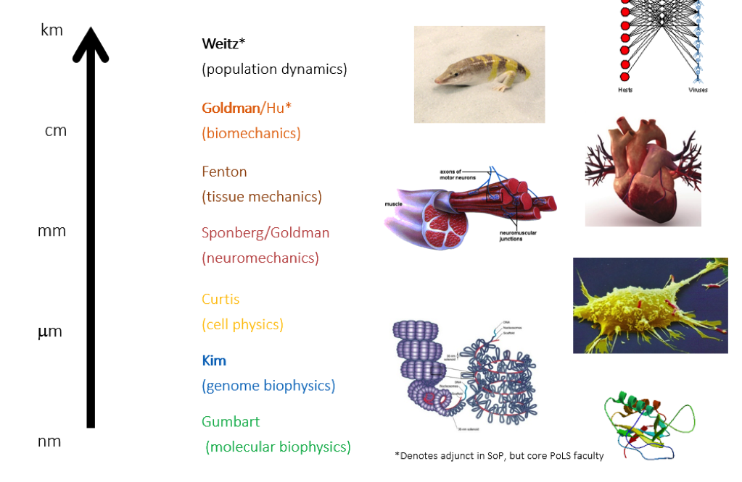
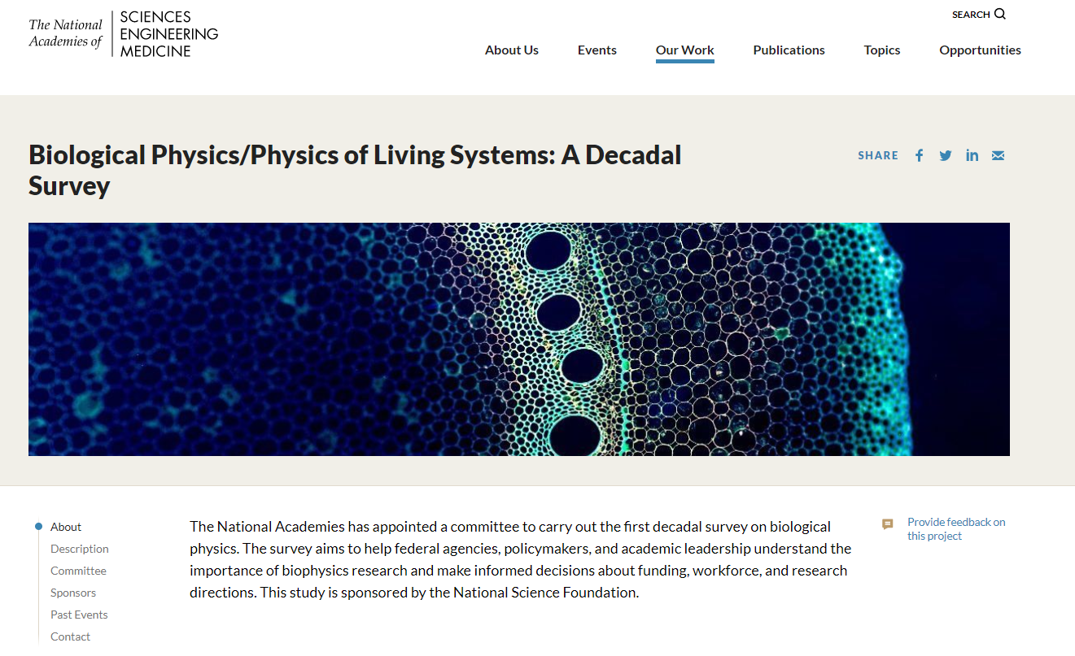
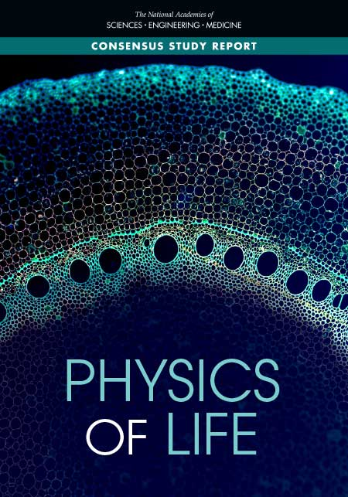
Physics of Living Systems in School of Physics
Physics of Living Systems (PoLS) at GT studies all scales!
m
/Bamla*
/Yunker

Slide 10
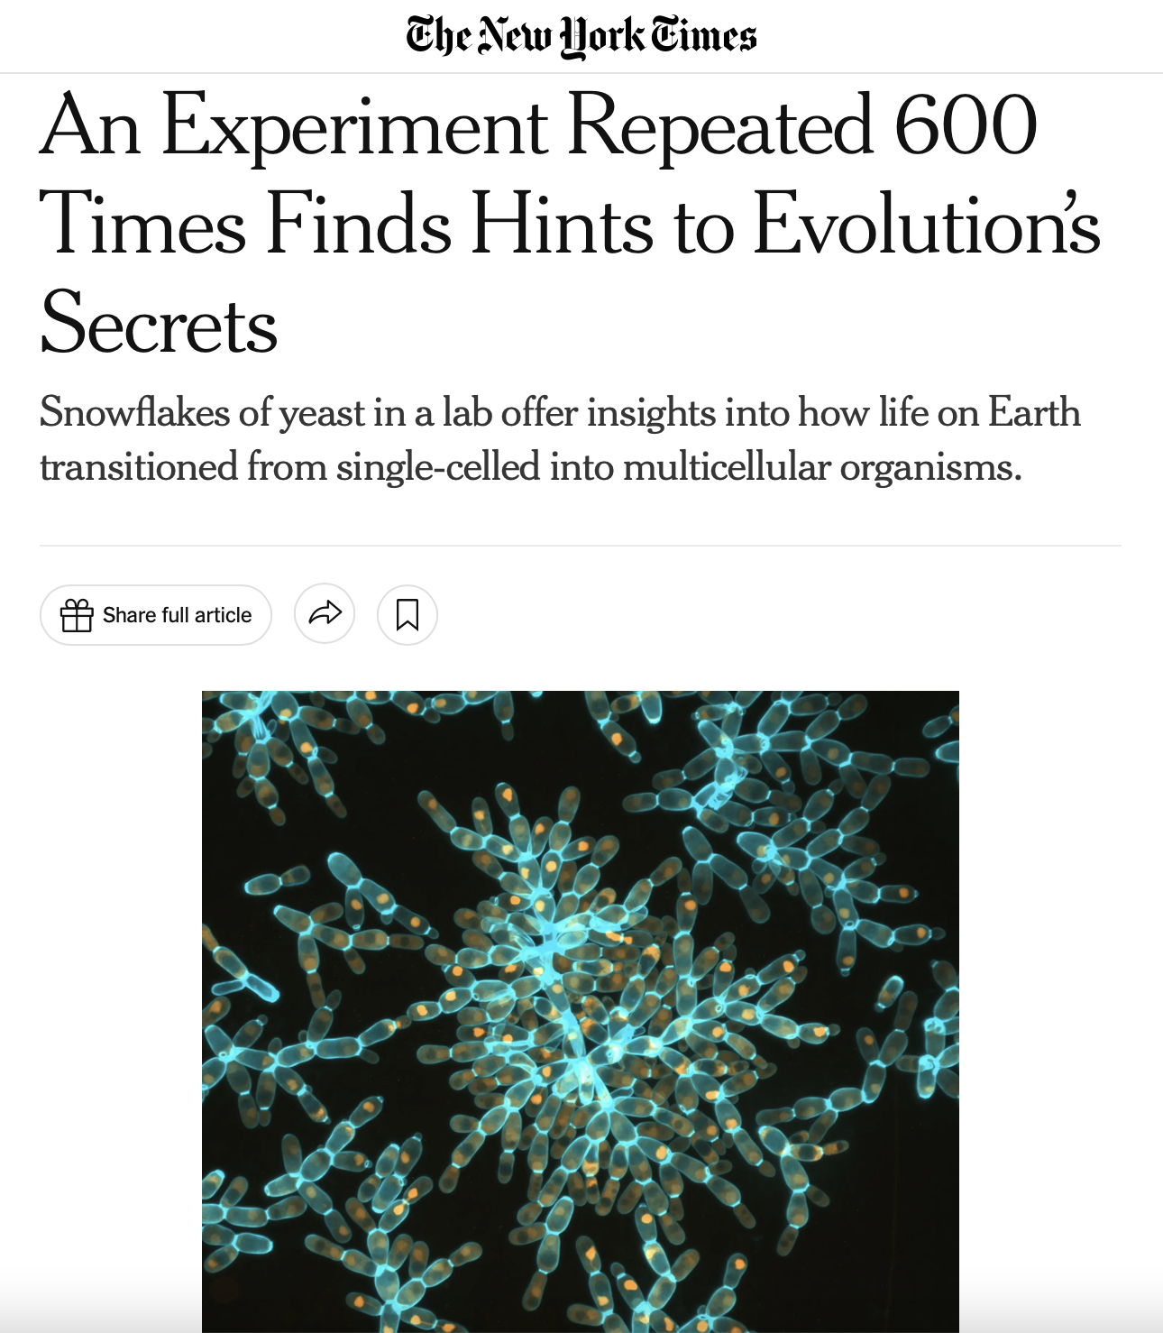
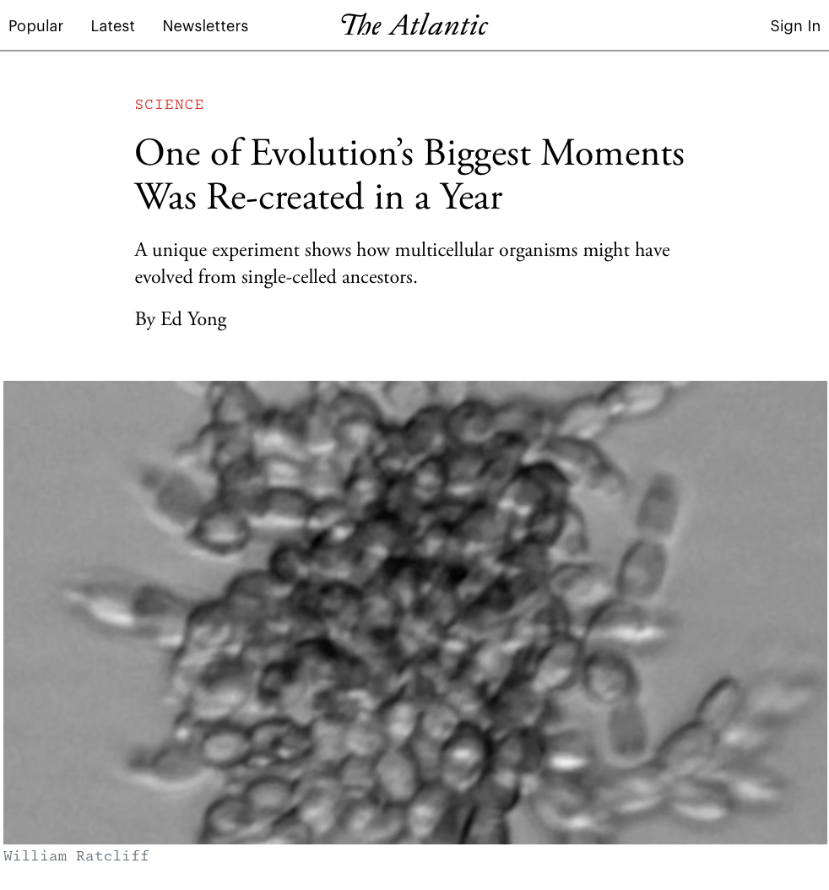
In the News: Breakthrough in Multicellularity
Peter Yunker and Will Ratcliff’s exciting work on yeast snowflakes made the news!

Slide 11
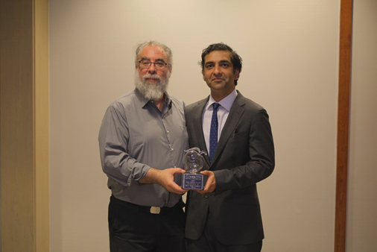
Recognitions for Research
Flavio Fenton and Neal Kumar Bhatia received the
2023 Team Science Award of Distinction for Early Stage New Research by the Georgia Clinical & Translational Science Alliance

Slide 12
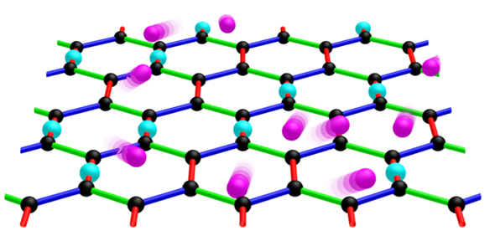
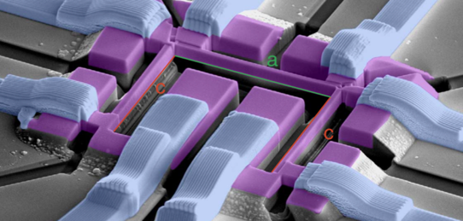
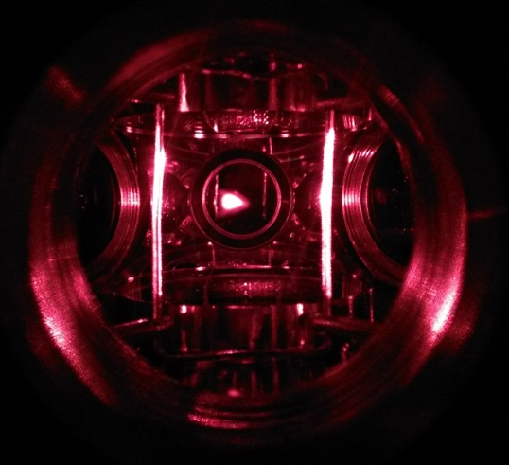
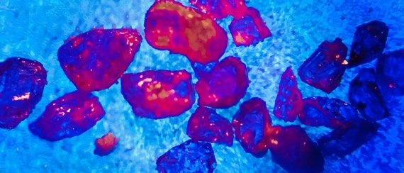
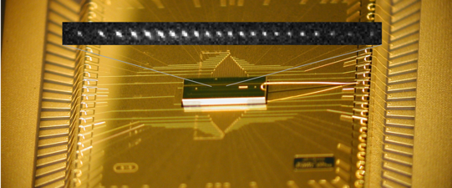
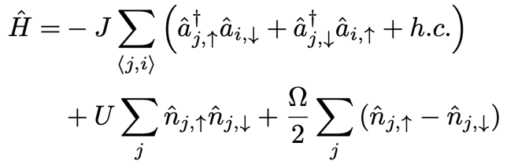
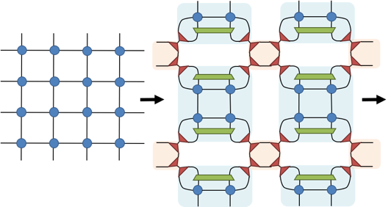
Quantum Sciences in the School of Physics
12 CMP + 6 AMO faculty
Condensed Matter
Quantum Information
Atomic, Molecular & Optical
Quantum Matter/Nano
Quantum Systems
Quantum Simulations
Experimental
Quantum Theory and Simulations
Theoretical

Slide 13
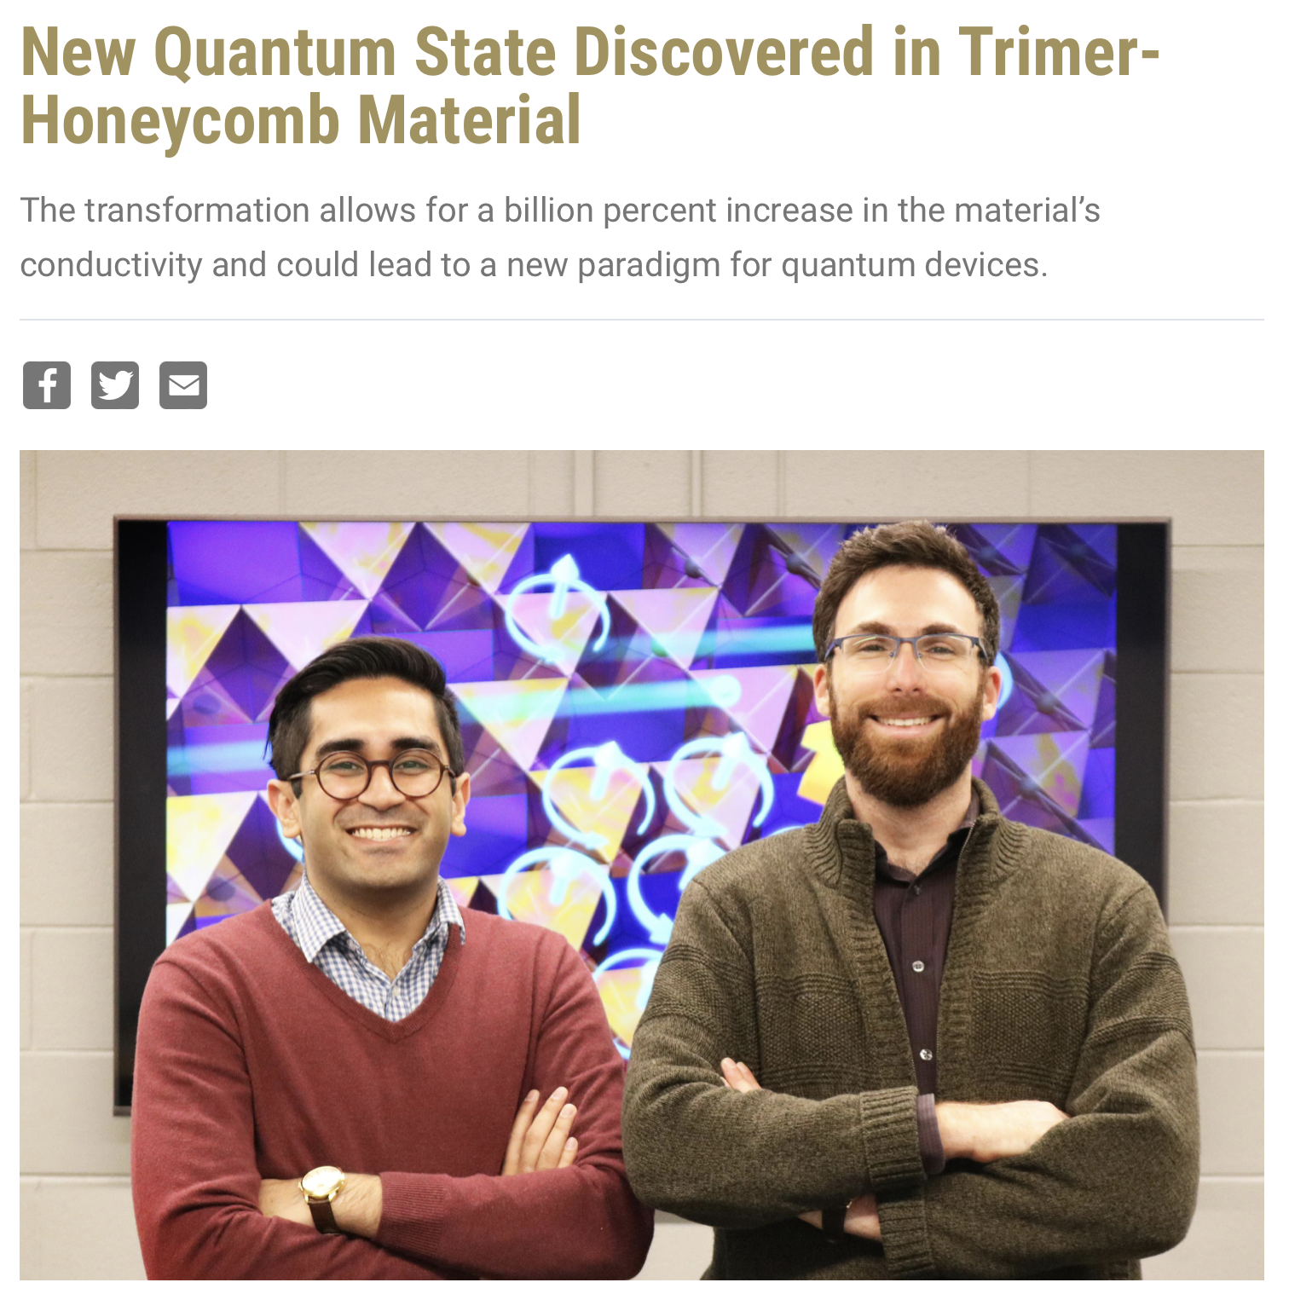
Recognition: New understanding in Colossal Magnetoresistance
Itamar Kimchi was awarded Georgia Tech Sigma Xi Best Paper
Award for his work on magnetic quantum chirality
Sami Hakani and Itamar Kimchi
Notes:
colossal magnetoresistance, an extreme enhancement in a material’s electrical conductivity when a magnetic field is applied. Studied current loops to explain why this material has a directional dependence.

Slide 14
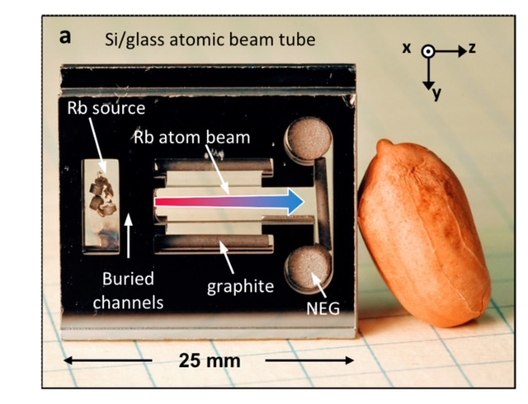
Atomic Beams in a Chip
(aka Raman lab going nuts!)
Chandra Raman’s lab made a breakthrough on miniature
atomic clocks
Notes:
It combines the strengths of atomic beam clocks, known for their precision and stability, with the portability and low-power capabilities of chip-scale atomic clocks (CSACs). Applied for a patent.

Slide 15
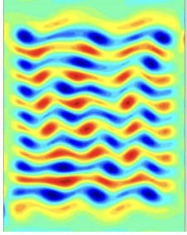
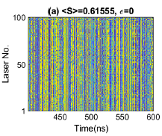
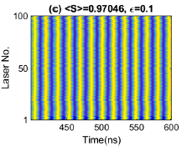
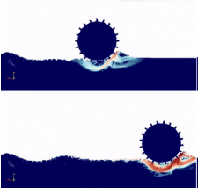
Nonlinear Science in the School of Physics
Nonlinear Oscillators
Fluid Dynamics and Turbulence
Locomotion on Complex Surfaces

Slide 16
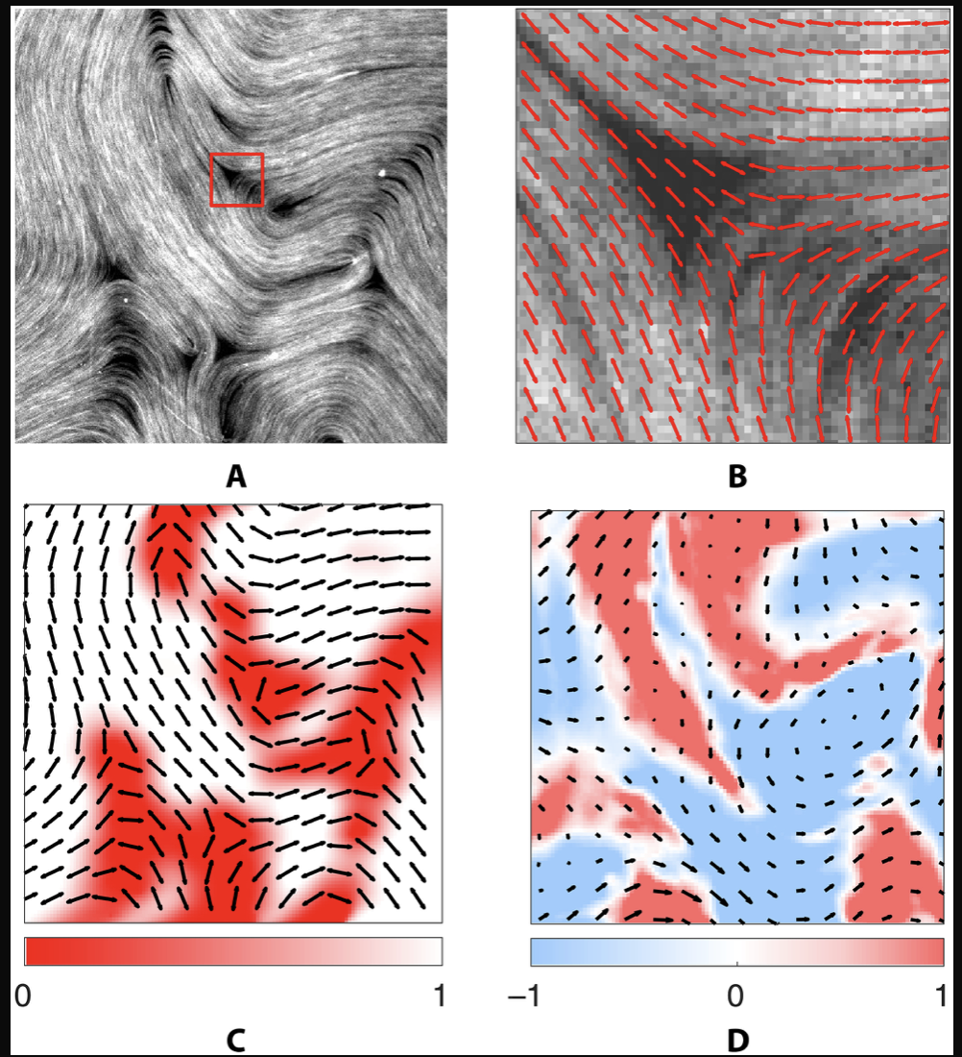
In the News: ML-led Physics Discovery
Roman Grigoriev’s group (work led by Matt Golden) was featured
on the cover of Science Advances for their novel model discovery
approach.
Notes:
Behavior of microtubules in fluid flow. Infer governing equation from time series of director and velocity fields.

Slide 17

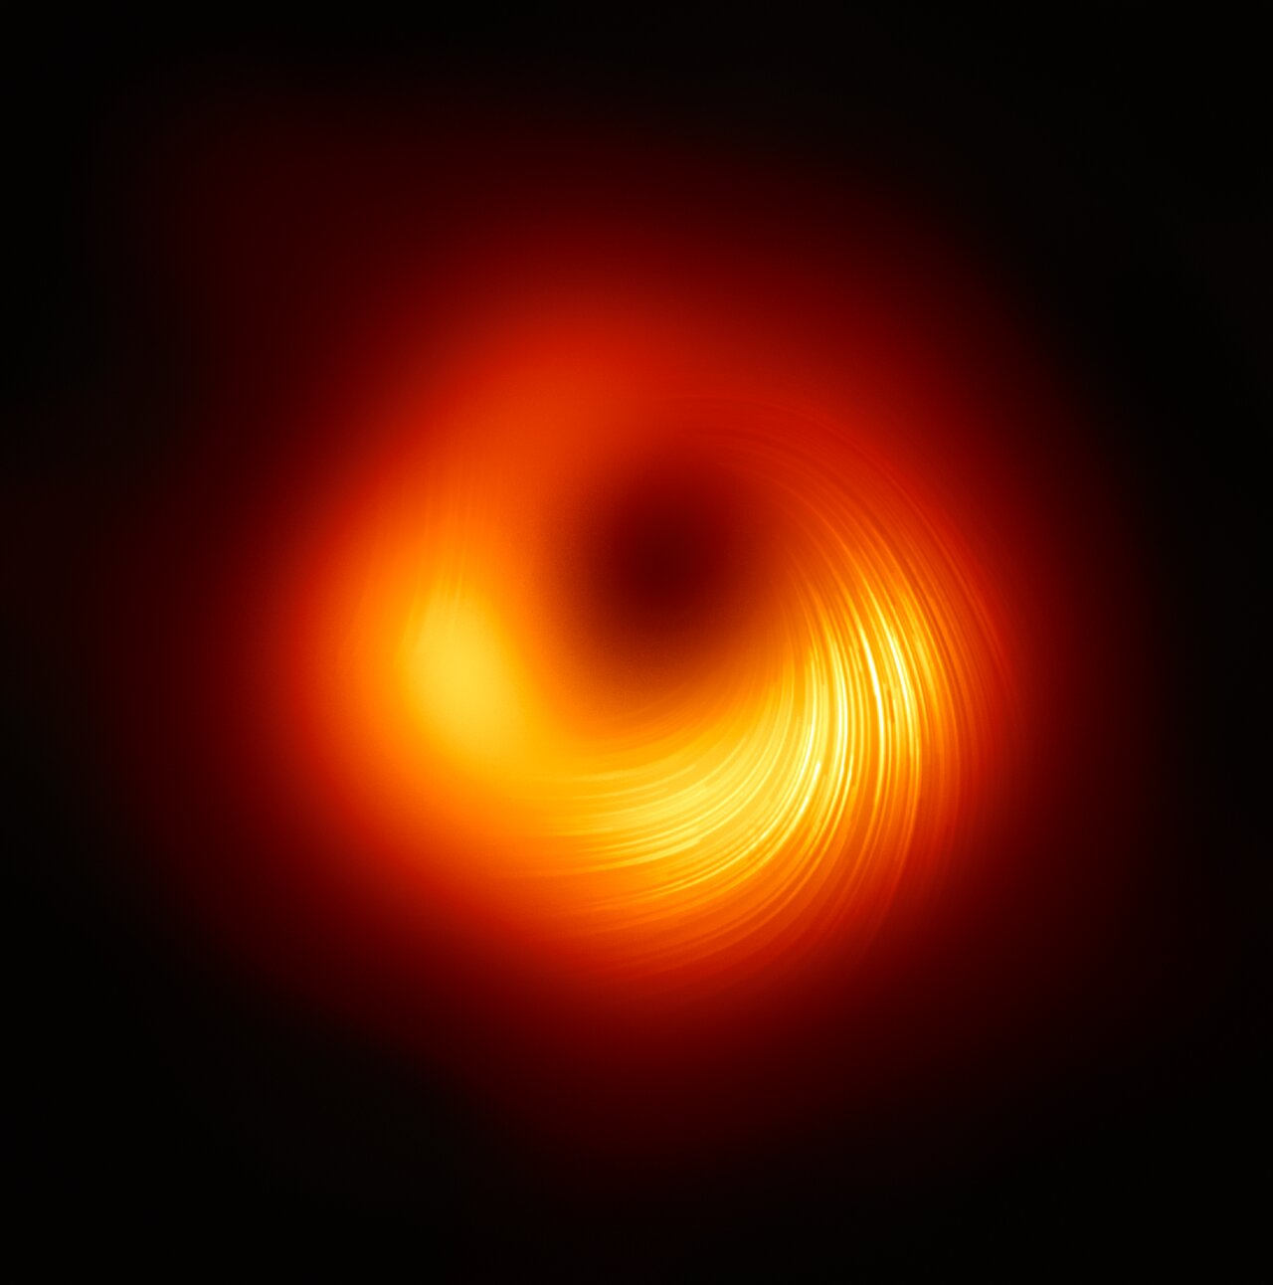
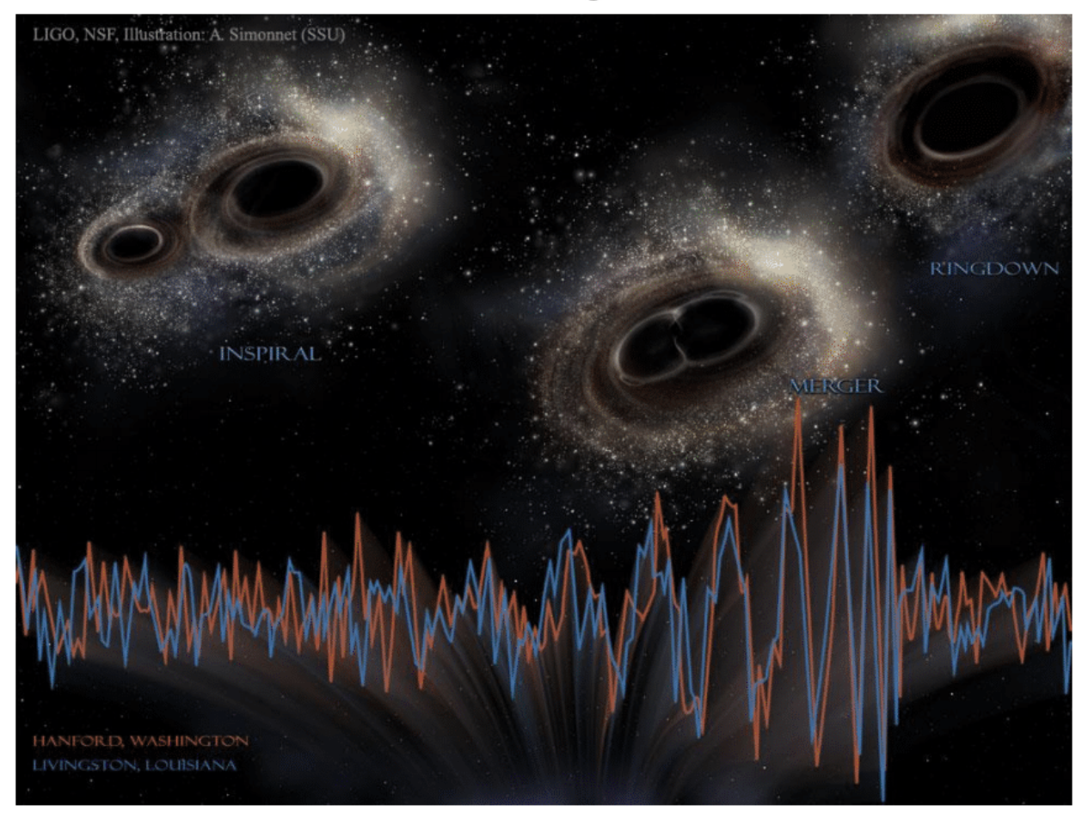
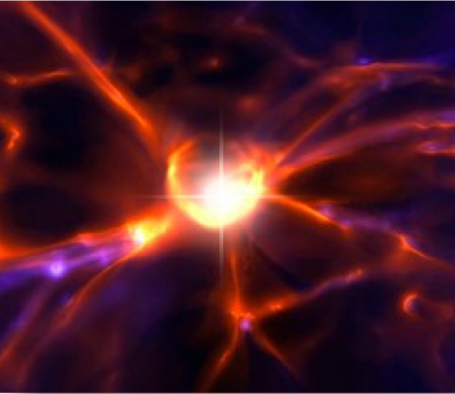
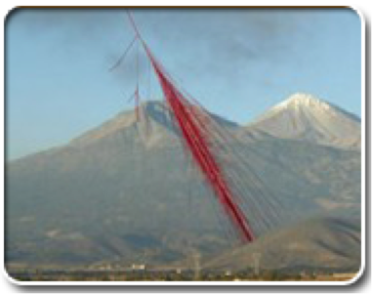
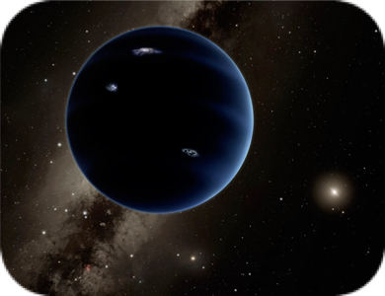
Astrophysics in the School of Physics
The first stars and galaxies
in the universe
Supermassive Black Holes
Gravitational Waves
Astroparticle Physics
Extrasolar
Planets

Slide 18
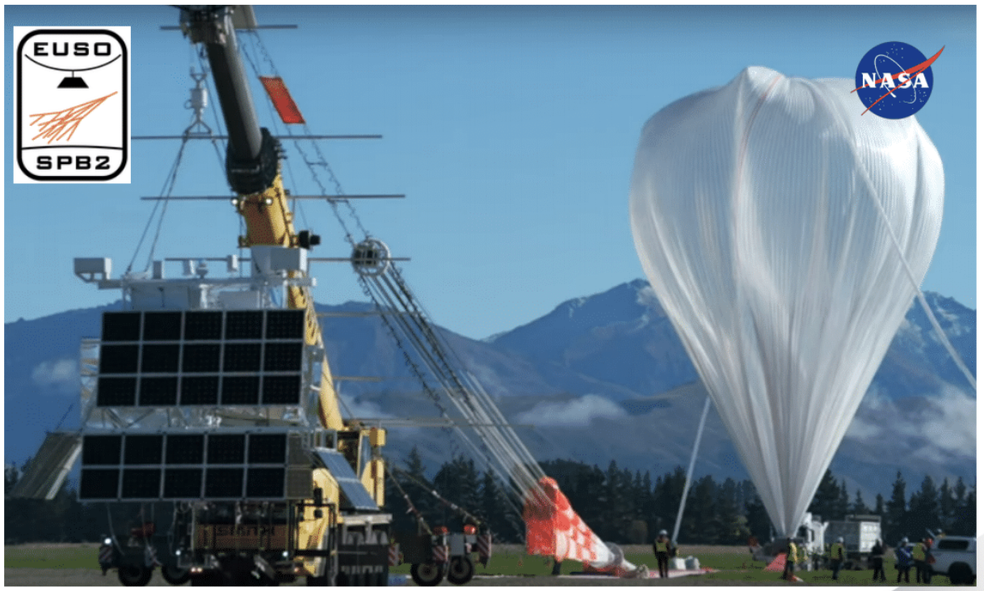
Exciting Results from Balloons
Nepomuk Otte’s NASA balloon experiment launched from
New Zealand this year to detect ultra-high energy neutrinos!

Slide 19
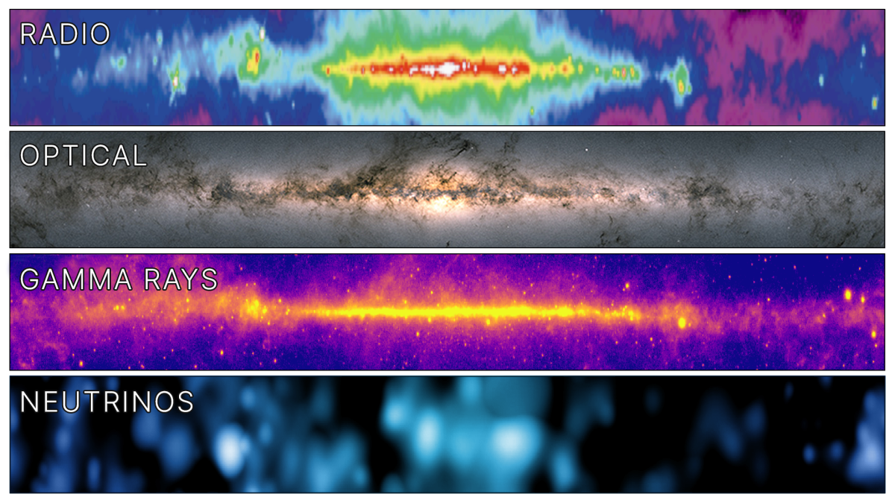
In the News: Neutrinos from the Milky Way
Ignacio Taboada shared IceCube’s observation of high energy neutrinos from our own Galaxy at an event in Philadelphia on June 29. Interviews included Reuters, NPR, Physics (APS), VICE, El Pais, Phys.org, Smithsonian magazine and SINC.

Slide 20
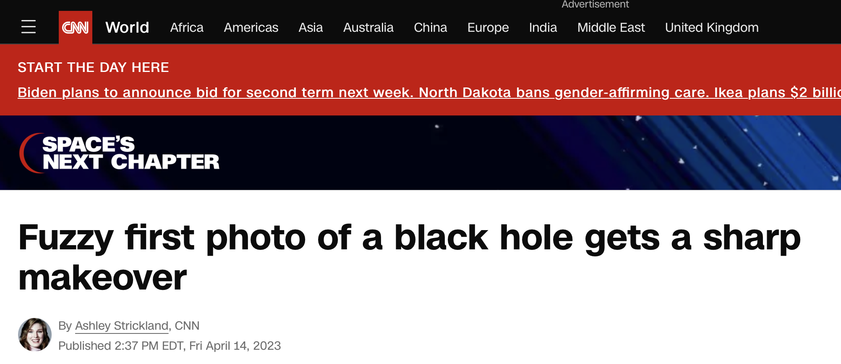
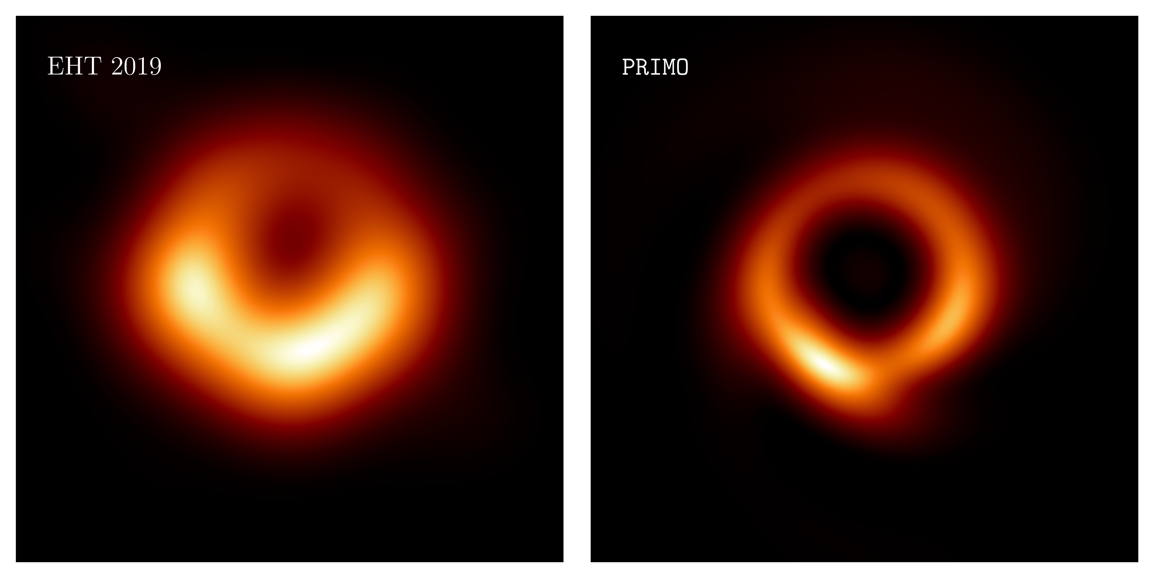

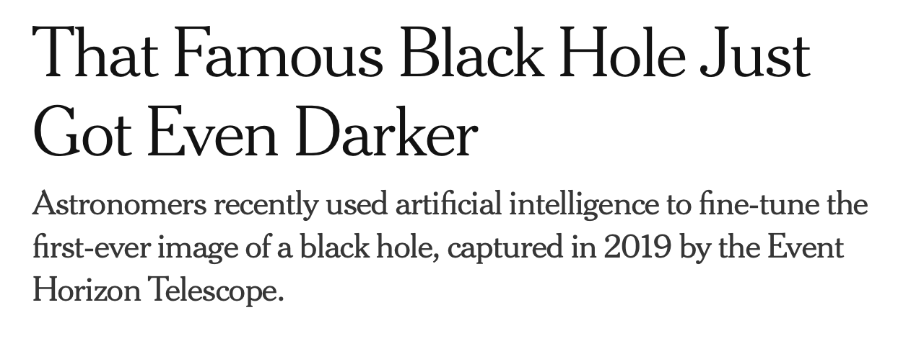
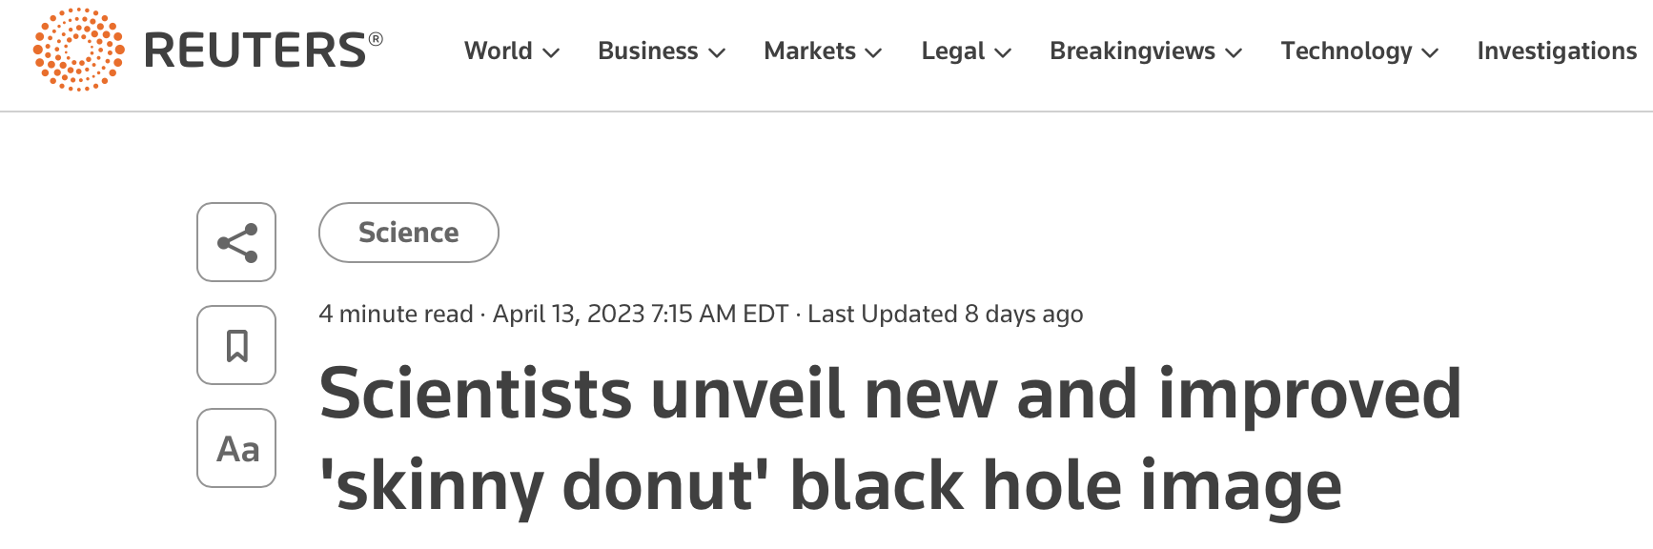
In the News: Skinny Donuts
Sharper Black Hole Images with ML Algorithms
From the Xtreme Astrophysics group

Slide 21
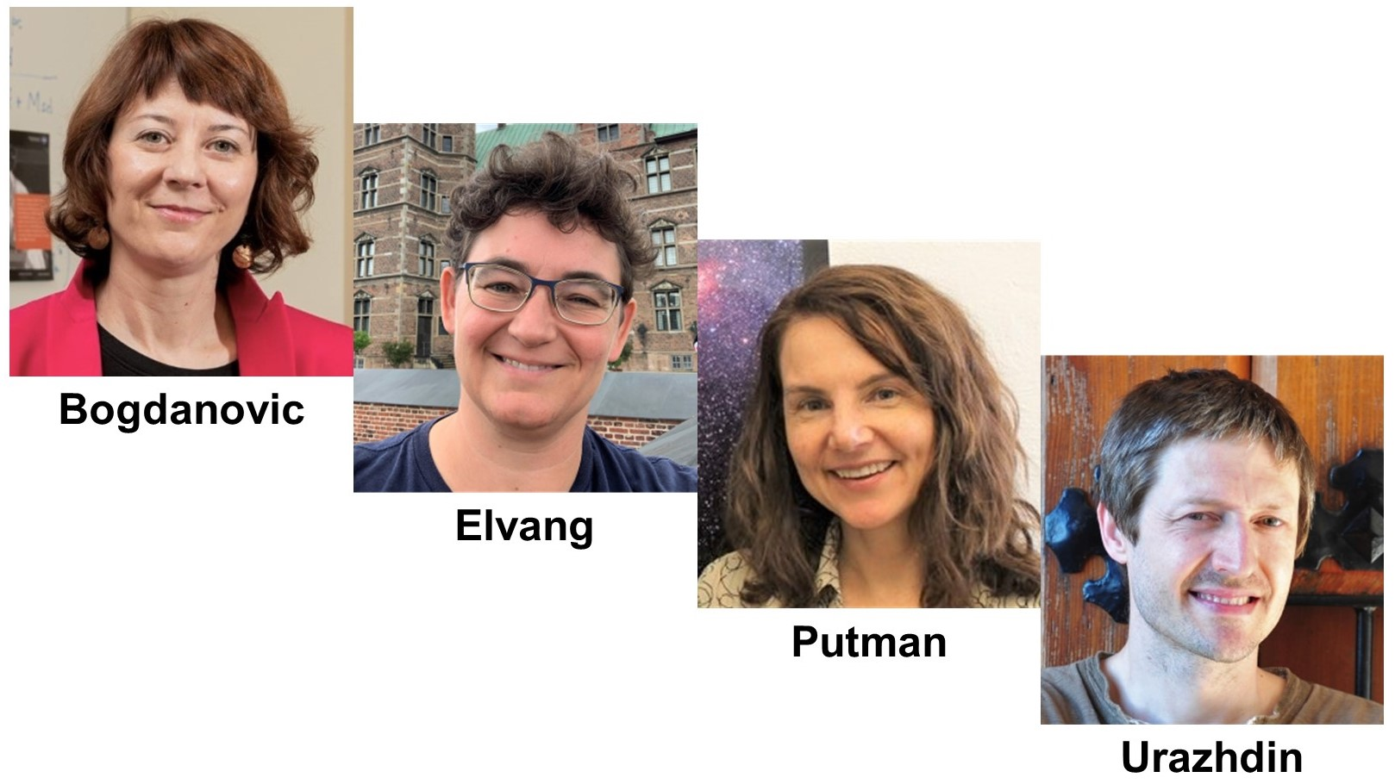
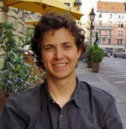
Faculty Awards
Tamara Bogdanovic
Received a Cottrell Scholar 2023 SEED Award for Research in Astrophysics
Simon Sponberg
Received the Shurl & Kay Curci Foundation award to study the structure and dynamics of precise timing in insect motor control.
Notes:
Simon also has a leading role GT Neuro Initiative, which is reorganizing neuroscience on campus.

Slide 22
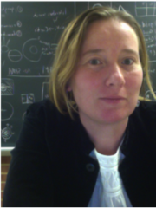
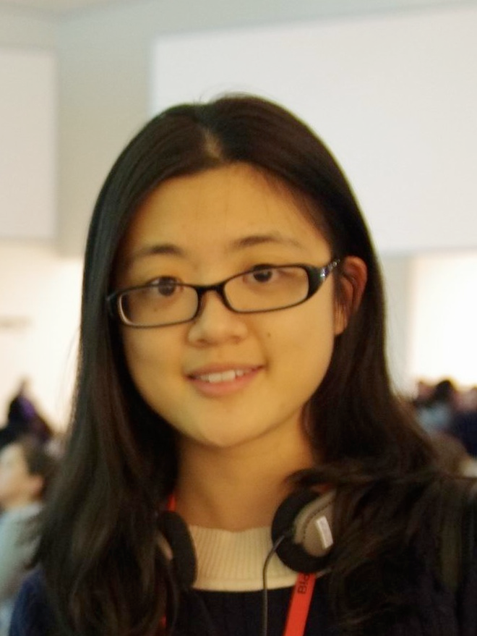
Faculty Awards
Jennifer Curtis
became the COS ADVANCE professor
Gongjie Li received the CTL/BP Junior Faculty
Teaching Excellence Award

Slide 23
Staff Recognition
Gary Longstreet
Leadership in Action Award
Shaun Ashley
Nominated and accepted as member of the
College Staff Advisory Council
Mytrail Wright
1 year Staff Service Award Anniversary

Slide 24
Education Highlights
New Astro Lab offering
New Advising Structure for Majors
Intro Physics Merger
Advanced Lab Upgrade
Approaching 300 majors!
Working on offering an astrophysics major and a quantum minor
Successful graduate recruiting year

Slide 25
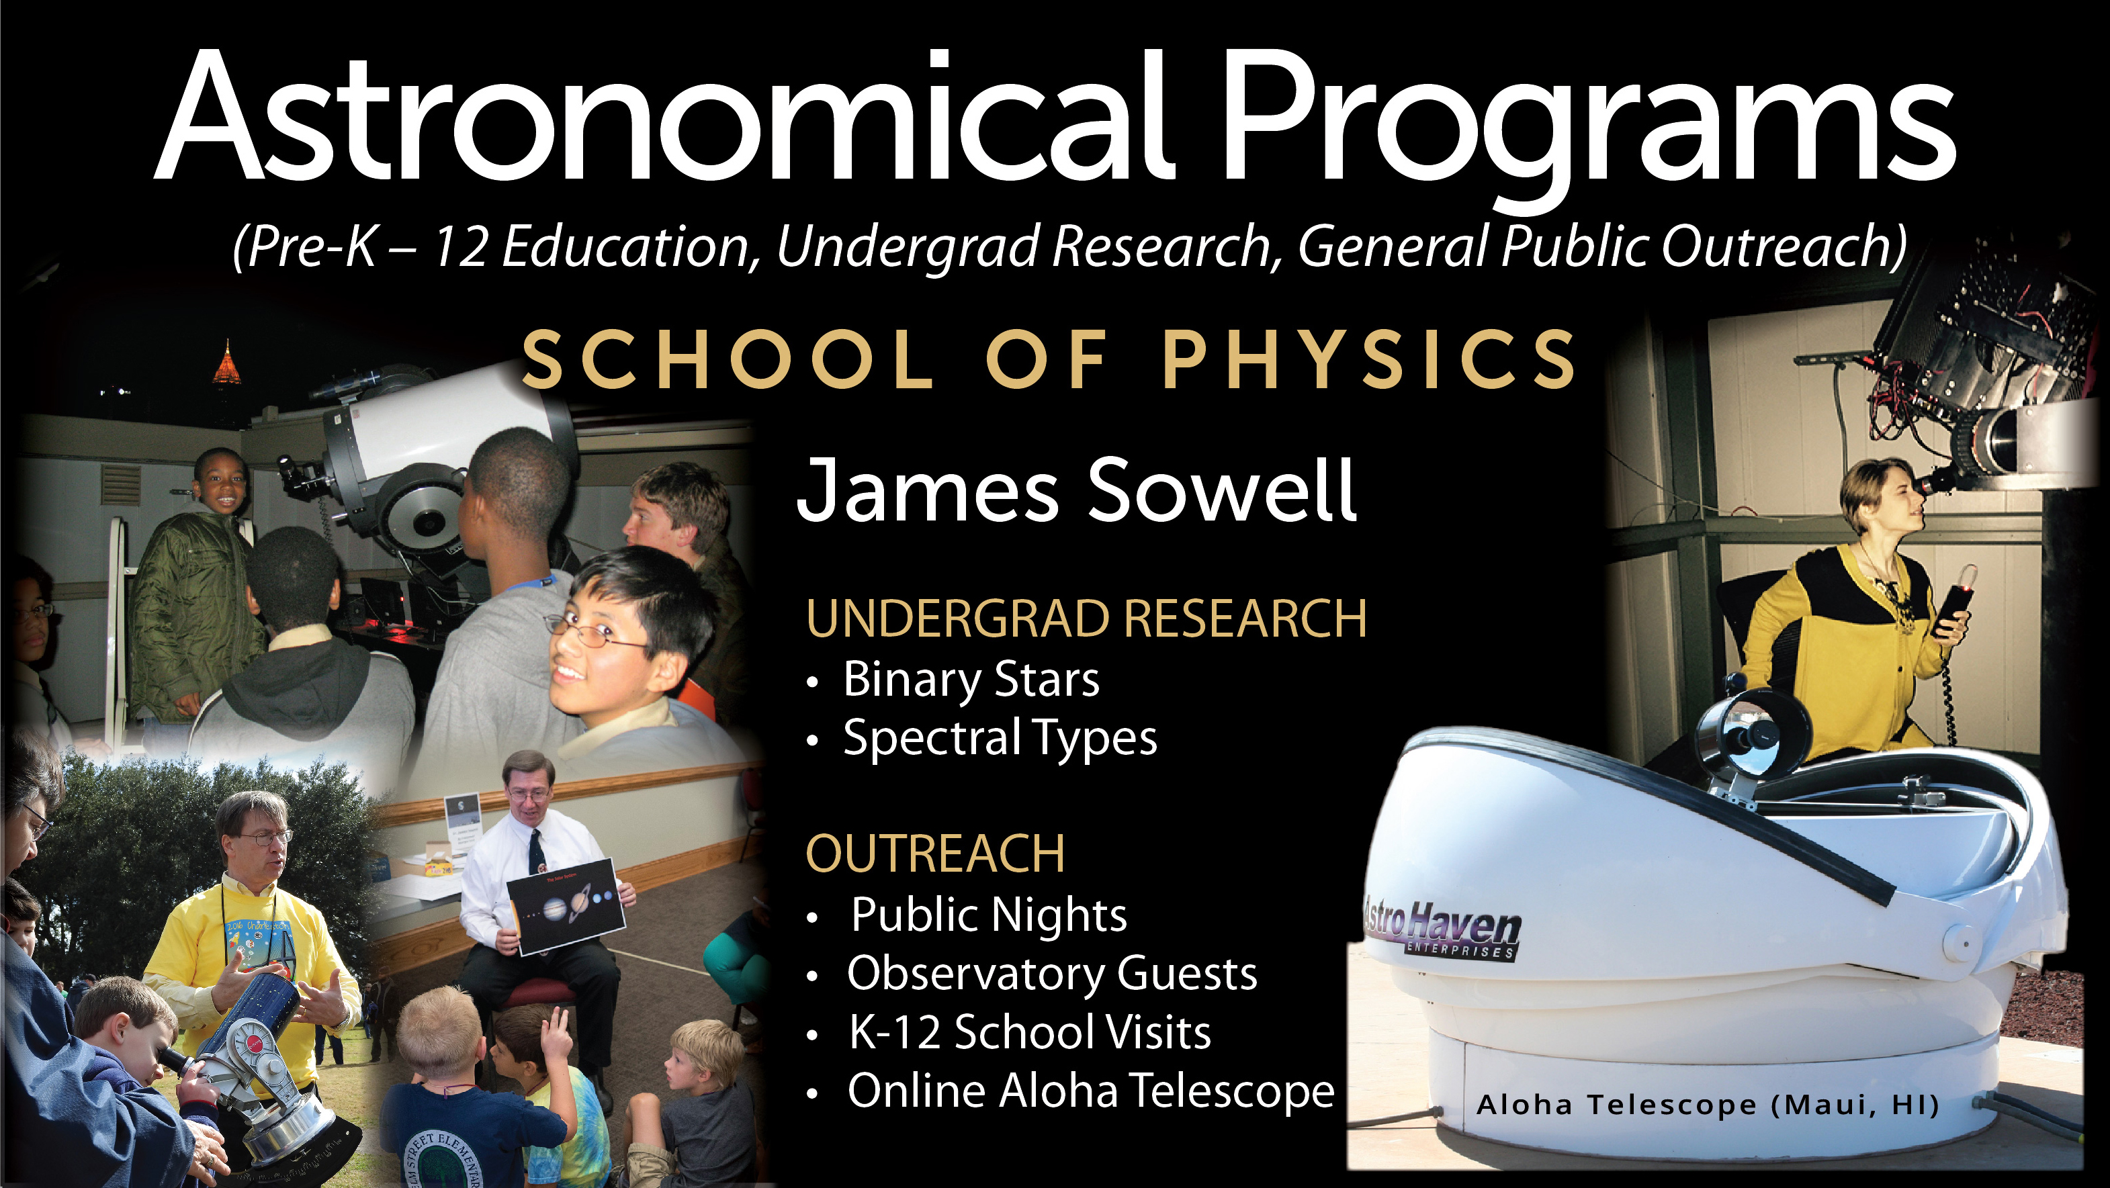
Telescope Outreach
OUTREACH
Public Nights
K-12 School Visits
Online Programs
Aloha Telescope

Slide 26
Graduate student awards and fellowships
Sami Hakani (Kimchi Group) and Alisha Vira (First/Jiang Groups)
Bonnie B. and Charles K. Rice Jr. Fellowships
Leo Wood
CTL Outstanding GTA 2023
Tony Lemos (Kim group)
Goizueta Foundation Fellow 2023
Kelimar Diaz (Sponberg group)
Best paper in Organismal Behavior and Physiology in QBioS 2022

Slide 27



Student Highlights
Chris Roper won a NNSA
Lab Graduate Fellowship
Lila Nassar won a NSF
Graduate Fellowship
Nadia Qutob won a
Barry Goldwater scholarship

Slide 28
UG Student Awards
Lila Nassar Class of 2023, Physics
COS Robert A. Pierotti Memorial Scholarship
NSF Graduate Research Fellowship 2023
Nadia Qutob
Barry Goldwater Scholarship 2023
Velin Kojouharov - Goldwater Scholarship and Astronaut Scholarship for undergraduate research in STEM 2023
Joonha Hwang - Best Oral Presentation for College of Sciences at Georgia Tech Annual Undergraduate Research Symposium
Lance Lampert
COS A. Joyce Nickelson and John C. Sutherland Undergraduate Research Award

Slide 29
UG Student Awards
Julianne Tijani
COS Roger M. Wartell and Stephen E. Brossette Award for Multidisciplinary Studies in Biology, Physics, and Mathematics
Aulden Jones and Nicholas Maldonado
The Hitohiro Fukuyo Scholarship in Physics
Ethan Atkinson and Pranav Muthukrishnan
The Joyce M. and Glenn A. Burdick Award
Ethan Coburn, Oscar Haase, Stanislaw Kowalski,
and Rehaan Naik
Letson Summer Internship Fellows

Slide 30
2023 Sigma Pi Sigma Honor Society Inductions
Sigma Pi Sigma was founded by students and exists to honor outstanding scholars in physics and astronomy, encourage interest in physics and astronomy among students at all levels, and to promote the service of its members towards their fellow students, colleagues, and the public.
Eric Swiler
Miller Chen
Lila Nassar
Wesley Ford
Michael Pacocha
Joshua Herring

Slide 31
Recent PhD Graduate Success
Fall 2022:
Kelimar Diaz Cruz
Vinod Gaire
Jyothishraj Nambisan
Michael Ryan
Holly Tinkey
Bochao Wei
Spring 2023:
Xiao Chai
Pranav Dave
Thomas Day
Danielle Skinner
Summer 2023:
Hareesh Gautham Bhaskar
Matthew Golden
Nathaniel Moore
Joshua Pughe-Sanford
Feng Xiong

Slide 32
2023 Physics REU
Physics REU was renewed for its 3rd round of funding
13 students participated in summer 2023 from around the country! We welcomed 4 students from Morehouse and Spelman.
For the first time, the REU cohort visited the National Laboratory known as the ‘Mag Lab’ in Tallahassee, Florida. And saw the strongest magnet in the world (45 Tesla). Thanks to Zhigang Jiang and Martin Mourigal for arranging this!
From the very first GT Physics REU cohort in 2016, Dr. Kelimar Diaz graduated with her PhD in QBioS.
Two REU alums started grad school at GT this year.

Slide 33

REU Faces

Slide 34

REU Students 2023

Slide 35
Conferences in SOP: Summer 2023
Dan Goldman and PoLS faculty organized and hosted the International Physics of living Systems Student Research Network Annual Meeting in August with 200 attendees

Slide 36

CUWiP coming to GT!
Georgia Tech was selected to host the Conference for Undergraduate Women in Physics (CUWiP) at GT early next year (Jan 19-21). This is the second time we will host it (last time in 2016), we expect to bring about 200 participating students for the meeting.

Slide 37

Hiring in the next year
Three new faculty position in the coming year
AI/ML-inspired physics initiative with two positions
Physics of Living Systems with one position

Slide 38
GOALS for next year
Postdoctoral fellowships at GT Physics
Renovate and modernize Howey
Continue strong, diverse recruitment
Invest in industry engagement opportunities

Slide 39
Onward and Upward
Our peers are recognizing the tremendous momentum in the School in the US News Graduate School Rankings
SOP Physics went from 28th to 21st spot
in 2023!

